Slide 1
Data Warehouse

Slide 2
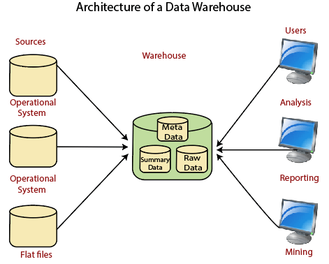
Data Warehouse

Slide 3
Data Lake
A data lake provides a scalable and secure platform that allows enterprises to:
ingest any data from any system at any speed—even if the data comes from on-premises, cloud, or edge-computing systems
process data in real time or batch mode
analyze data using SQL, Python, R, or any other language, third-party data, or analytics application.

Slide 4
Data Engineering
ETL
Source - flat file, text, database table… raw data
Extract Data
Stage – loaded with raw data
Transform – cleaning, processing, calculation
Main
Load – load the main DB tables.
SQL Server Integration service(SSIS), Pentaho, SAP BODS,informatica,

Slide 5
Data Science
Use data from datawarehouse and perform different operations..
Python, R, Java

Slide 6
Tools
SQL
SQL Server Management Studio – Microsoft
SQL Server
Python
Jupyter notebook
Power BI – PB Desktop, PB pro..

